Slide 1
OS/Shell Introduction
Getting Started

Slide 2
Computer Accounts
Each student in the School of Engineering and Computer Science should have an ECS account.
Go the site: http://www.ecs.csus.edu/
Scroll to below the picture.
Click on ECS Quick Links
Choose the option Get an ECS Account
Follow the directions. You must present a OneCard when you pick up the information.

Slide 3
Logging onto a UNIX machine
Sit at a UNIX machine and log in.
Do a remote login using SSH
Most of us use PuTTY software to accomplish this.
The ECS computers all have PuTTY
To get PuTTY at home, download it from: http://www.chiark.greenend.org.uk/~sgtatham/putty/

Slide 4
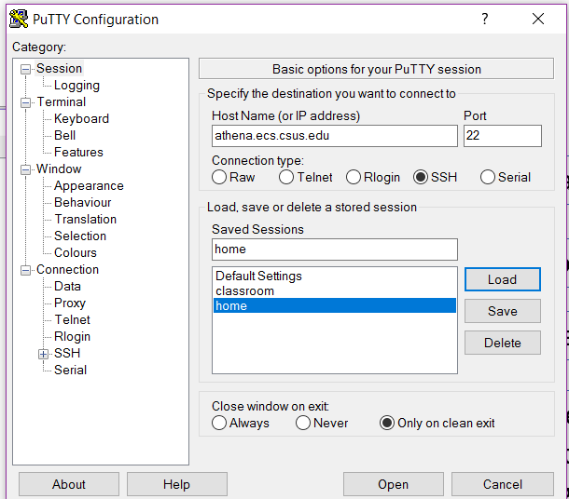
PuTTY Screen
Address of “athena”
Choose the option - SSH
I saved the session, named it “home”
Once the session is saved,
we can just double click on the session name,
and the log-in window will appear
Contains options to change font and font size

Slide 5
MAC Users
Open up a terminal/console window and type the following:
ssh yourECSname@athena.ecs.csus.edu
Press Enter.
When prompted, type “yes” to accept the server’s key.
Then enter your password.

Slide 6
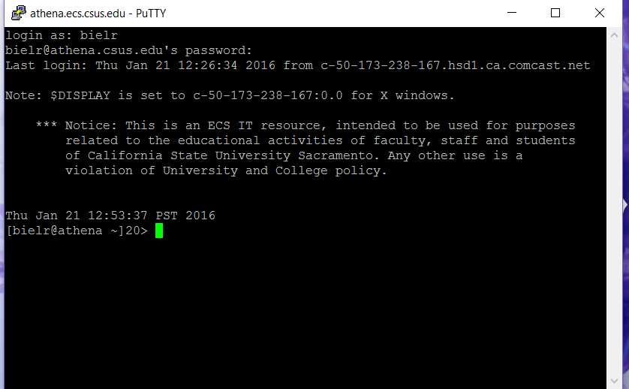
Login Screen

Slide 7
Shells:
A shell is an interface between you and the kernel of UNIX/Linux.
Kernel. The center, the core.
Shell. A way to communicate with the Kernel.
The default on our system is csh, read aloud as ‘C-shell’.

Slide 8
By doing “cat /etc/shells”, I found that athena has:
sh (Bourne Shell)
bash (superset, Born Again Shell. LOL)
nologin
tcsh
csh (spoken as C-shell) (Default on athena)
dash
ksh
It is possible to change the default shell,
using the command “chsh”.

Slide 9
Shell Verification
To see what Shell you are in, type:
> echo $SHELL

Slide 10
Getting help:
“Look at the “man” page.” You will hear this.
This means looking at the on-line manual which is extensive.
$ man command
Examples: /* will show you… */
$ man ls /* all the options for listing */
$ man gcc /* options for the compiler */
Maneuvering through the man page:
Hit space bar to advance thru page.
Hit Enter to advance the screen one line.
Hit “q” to quit.

Slide 11
Various Commands in UNIX/Linux

Slide 12
Command: ls
Purpose: List files in directory.
Format: ls [options] [file-list]
Some Options:
-a List all files, including hidden ones.
-d List directory names only, not ordinary files.
-g Show group information with listing.
-l Show long listing with extended information.
-r List in reverse order.
-s List in order of increasing size.
-t List in order of time, most recent first.
Example: ls ls -ra
ls –l ls -ls

Slide 13
Copying and Renaming Files:
Command: cp
Purpose: Copy a file.
Format: cp source-file target-file
Example: cp my.file file2
Result: There are now two identical files with different names.

Slide 14
Moving or renaming files:
Command: mv
Purpose: Move or rename a file.
Format: mv source-file target-file
Example: mv my.file file2
Result: One file with the target name exists.

Slide 15
Removing files:
Command: rm
Purpose: Remove a file.
Format: rm [option] file(s)
Option: -i Ask before deleting.
Often the default.
Example: rm file2
Result: The file is no longer listed or available.

Slide 16
The cat command:
Command: cat
Purpose: Display or create files.
Format: cat [source-file] [symbol] [target-file]
Examples: 1. cat this.month
2. cat lab1.c
Result: File displayed on screen, lines echoed on screen

Slide 17
Change The Prompt On athena (csh)
Change the prompt to show the folder/directory that you are in.
You need to type a SPACE after “set” and after the “m”.
Type in the command: set prompt=’[%n%m %~]!>’
The %n will show your name.
The %m will show your current folder.
The %~ will give you the command number.

Slide 18
REDIRECTION: (1 of 4)
$ ls /* lists all files in your directories */
$ ls | more /* pipes the output to the more program which
gives you a screen-full at a time */
The pipe symbol “|” redirects the standard output of one command to the standard input of another command or process.

Slide 19
REDIRECTION: (2 of 4)
Use > to redirect an output to a file.
So cal is the calendar command.
$ cal 2017 > my_calendar

Slide 20
REDIRECTION: (3 of 4)
Use >> to append to a file.
So ps means process status.
$ ps >> my_file
Whatever was in my_file will now have the listing from the
ps command appended to it.

Slide 21
Just to make things clear on Redirection: (4 of 4)
Use of the pipe “|” sends output to a process.
Use of the redirection “>” sends output to a file.
NOTE: The details of Redirection vary from shell to shell.

Slide 22
File structure
the root folder in linux is represented by /
the path contains folder names delimited with /
You home directory is represented as
/gaia/class/student/srivatss
Where first / is the root
gaia is the folder under root
class is a folder under gaia, student under class, ….

Slide 23
Change directory
cd folder_name
cd ..

Slide 24
Navigating the folders
The current folder is always represented as .
The parent folder is always represented as ..
cd folder_name will set the working directory to folder_name
ls will list all files in the in the working directory
Some misc commands
date
cal
pwd
who
finger
whoami

Slide 25
shell command – which
which is the command that tells you the path to the command
which mkdir will give the path of its existence
which pwd

Slide 26
Software for moving files between home and athena

Slide 27
Optional software for home (Windows only):
WinSCP – free software that allows one to move files from one site to another, from athena to home, and the reverse.
At the site: http://winscp.net/
Next slide shows startup menu with entries you will need

Slide 28
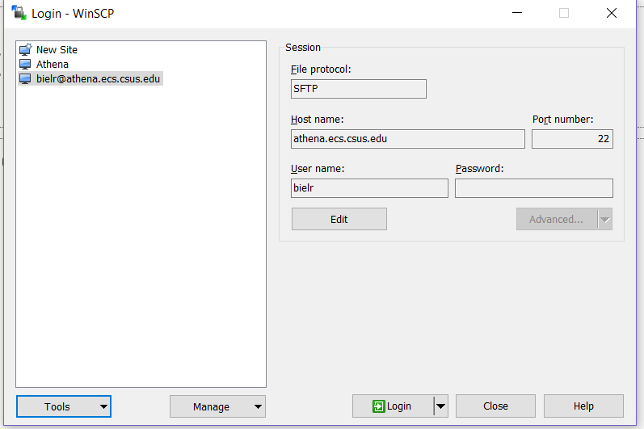
WinSCP
Log-in
Screen
with
settings

Slide 29
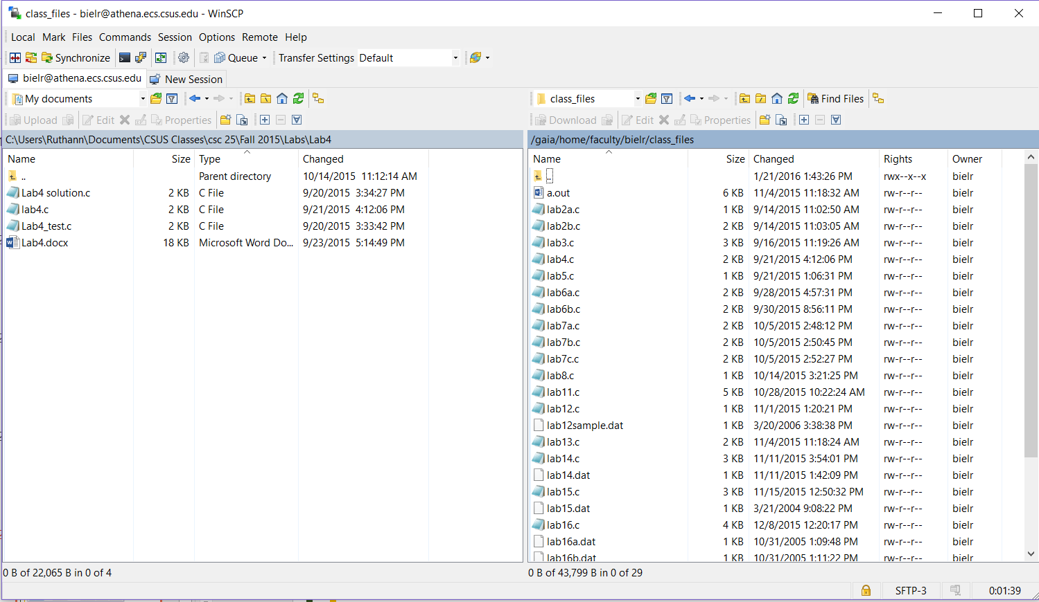
WinSCP Sample screen: left side is a folder on home computer, right side is folder on gaia

Slide 30
Optional software for home (MAC & Windows):
Free software that allows one to move files from one site to another, from athena to home, and the reverse.
Filezilla – https://filezilla-project.org/
Cyberduck - https://cyberduck.io/?l=en
Both software packages work on Windows or Mac.
A search on “cyberduck vs filezilla” will bring up a couple of articles.

Slide 31
OS/Shell Introduction
Getting Started
The End

